Slide 1
The Great Escape!
Maya slung her backpack off her back, waved to her friends, and plopped into her father’s car parked in front of school. She and Papi have a secret! Every Friday they go to the animal rescue shelter so that Maya can learn to take care of dogs and puppies.
Over the summer Maya saw a news show about a local veterinarian and the animals who come to her office to get well.

Slide 2
Maya and her cousin couldn’t believe that there were doctors who only treated animals! Can you believe it? That day Maya decided she would be a veterinarian, just like Dr. Rodriguez. Papi promised to help.
The animal rescue shelter welcomed Maya and gave her the job of feeding and playing with the puppies. Today there were so many puppies! Maya counted 12 as she opened the bin of puppy food.

Slide 3
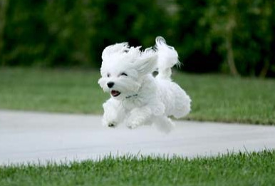
Just then Dr. Rodriguez opened the door and quickly closed it behind her so the puppies wouldn’t get out.
But it was too late!
Maya watched little puppy tails slip out the door behind the doctor. Oh no! Dr. Rodriguez quickly counted the remaining puppies, and said, “There are 7 puppies here, but how many got out? Let’s go look for them!”
Maya knew exactly how many puppies to look for. Do you?

Slide 5
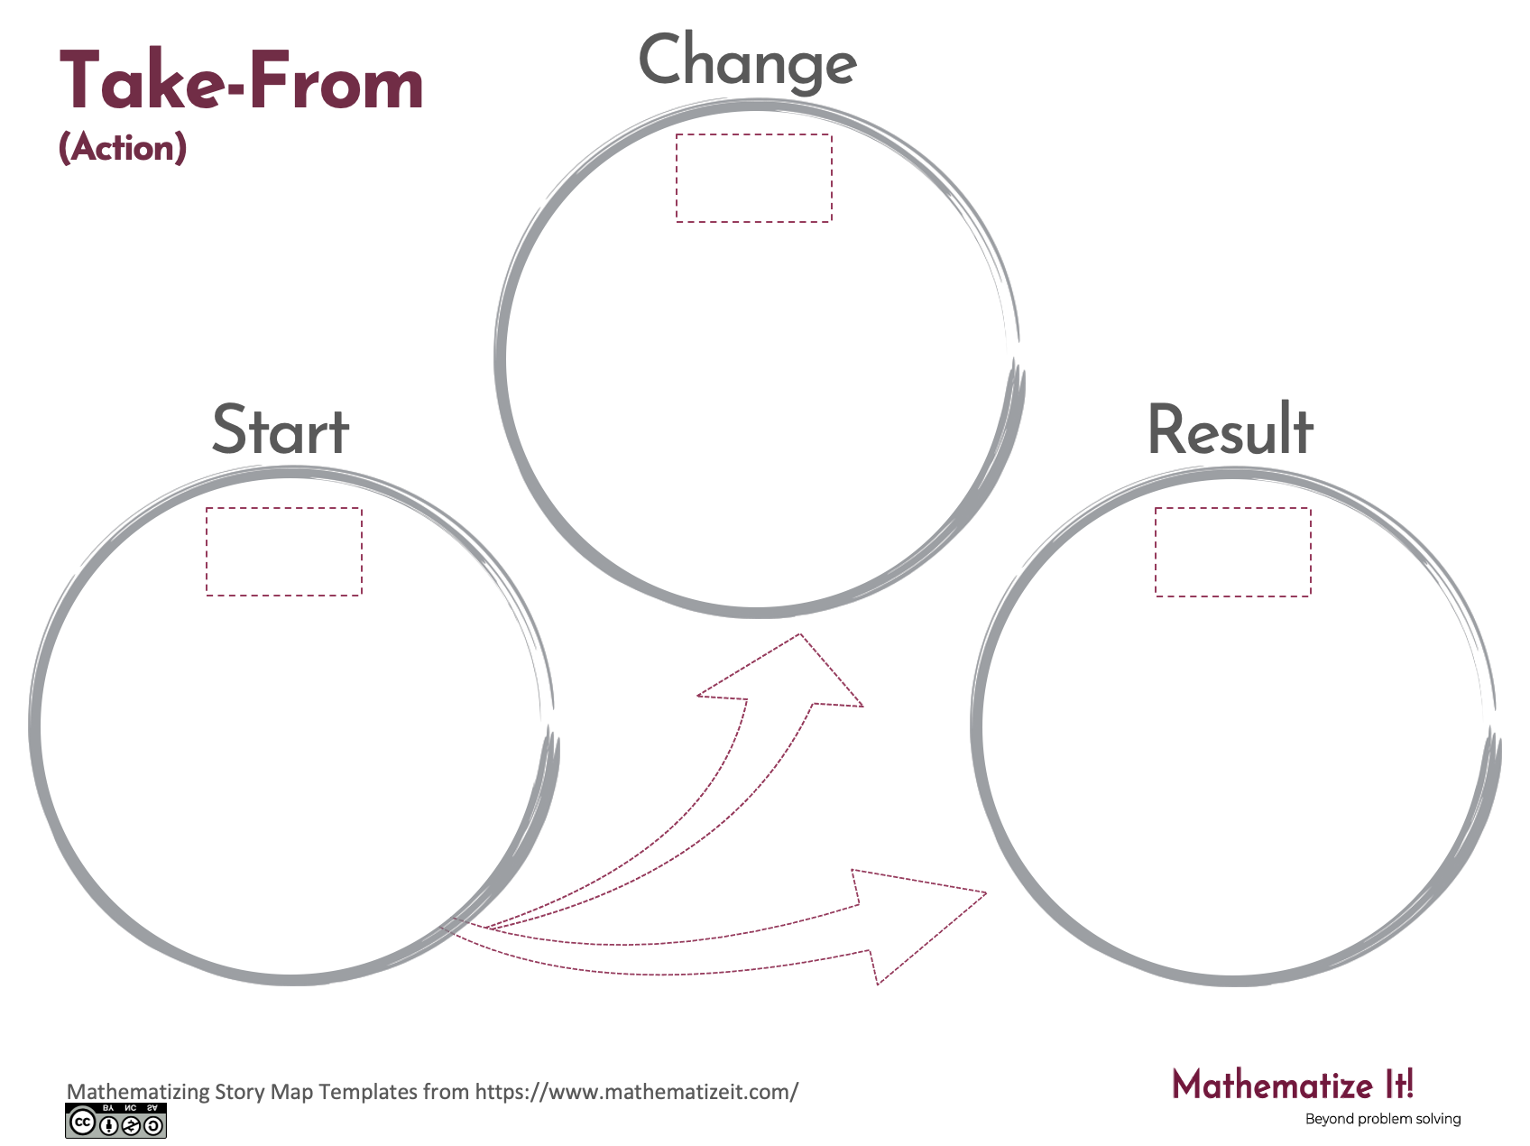
Click here to download a free student copy of the
Mathematizing Story Map
for Take-From problem situations, and more!

