Slide 1
Maya’s Big Surprise
Maya woke up and clapped her hands together. She had been excited about this day for many weeks! Today was the big day. She and her mom were going to surprise her cousin Julissa with a puppy!
Julissa, Maya and her mom drove many miles to a small house with a yard full of puppies playing in the grass. The girls quickly jumped out of the car and the puppies yipped a greeting .

Slide 2
The puppies rolled over Maya and Julissa so much that Maya wondered how many puppies there were.
Mami finally told Julissa the surprise. Julissa could get one of the puppies! Her mom said it was ok! Julissa smiled so much her cheeks hurt.
Maya smiled because her cousin was happy, but oh! She thought about how hard she had worked at the animal rescue shelter. She bent down and picked up a squirming puppy and held it tight, trying not to cry .

Slide 3
Mami touched her on the shoulder and said, “Surprise, Maya! You can have a puppy, too.”
The two girls got in the back seat and each held her own puppy tight all the way home. Then they learned that 8 more puppies still needed a home, and Julissa suddenly said, “I know how many puppies were in the yard!”
Do you know how many puppies there were in the yard that day?
.

Slide 5
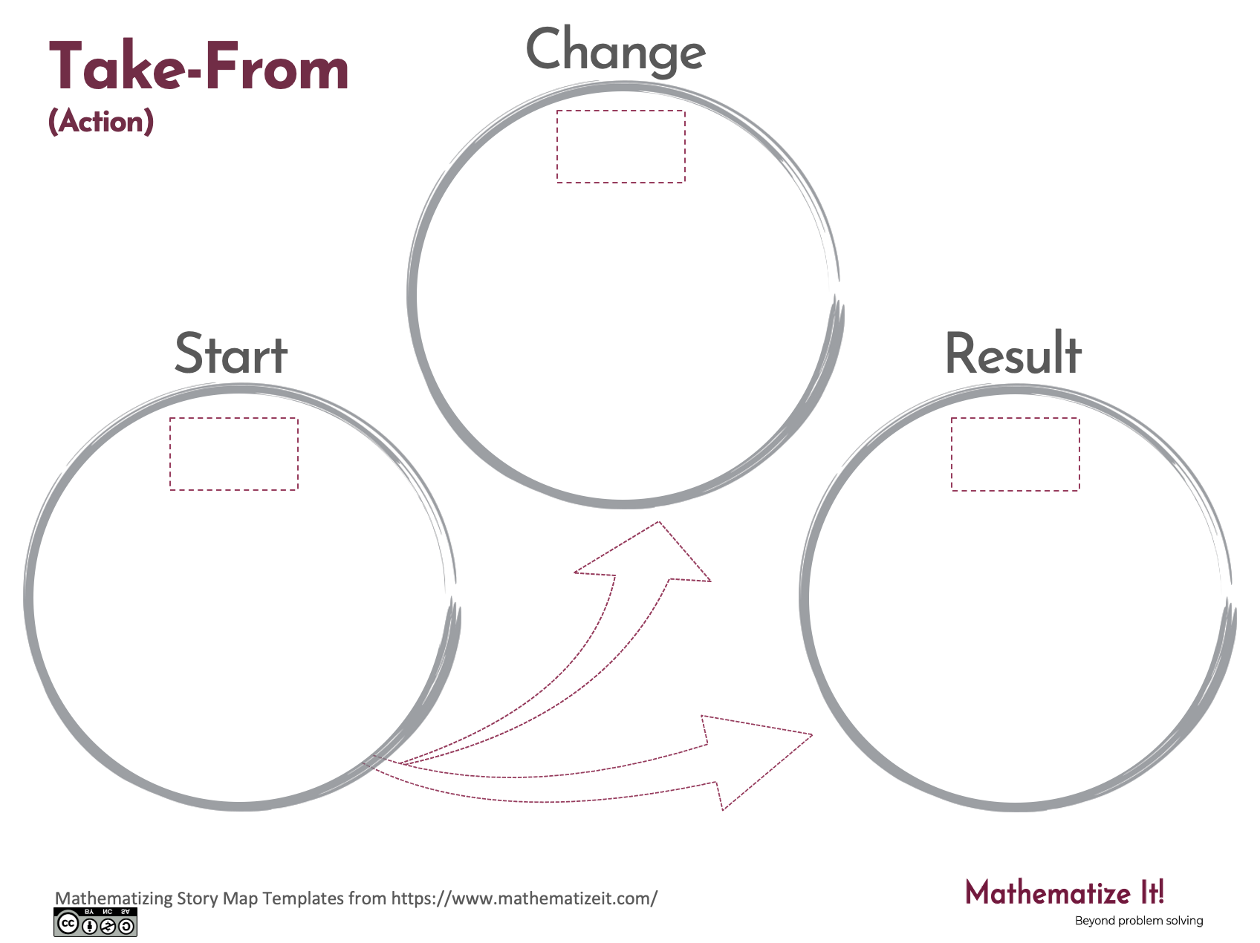
Click here to download a free student copy of the
Mathematizing Story Map
for Take-From problem situations, and more!

