Slide 1
Maya at the Dog Park
Have you ever been to the dog park? If you like dogs, you’d love it! A dog park is a grassy area with a fence all around the outside. It is a safe place to bring a dog to play. The dogs are allowed to run without a leash and play with other dogs.
Maya likes the dog park because one of the dogs, a happy and bouncy golden retriever named Sammie is often there.

Slide 2
A curious boxer bounded over to sniff a greeting to Sammie as the dogs ran toward the fence. Sometimes there are dozens of dogs in the park, but today Maya counted only 15 dogs in the park playing chase.
Suddenly Sammie’s person threw a ball and four dogs left the chase and raced after it. Sammie caught the ball first. She ran back and dropped the ball in front of her person.

Slide 3
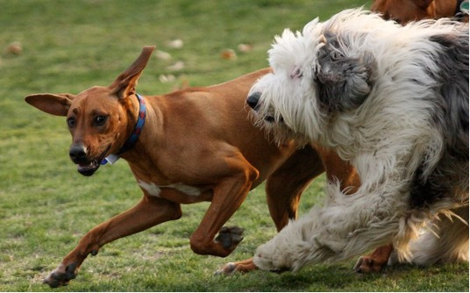
The group of pups waited patiently for him to throw it again.
Most of the dogs didn’t even notice the ball and they kept chasing each other across the park. Maya laughed out loud watching them play.
The dog park is such a fun place to be!
Can you imagine how many dogs were chasing each other?

Slide 5
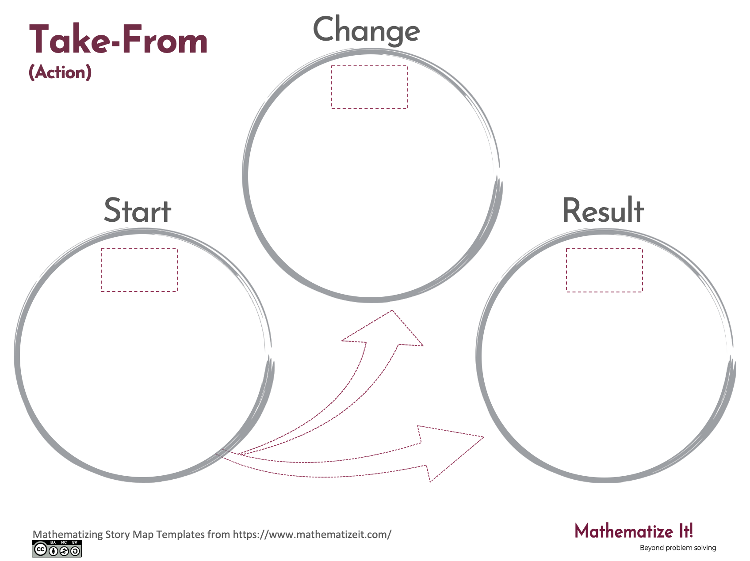
Click here to download a free student copy of the
Mathematizing Story Map
for Take-From problem situations, and more!

