Slide 1
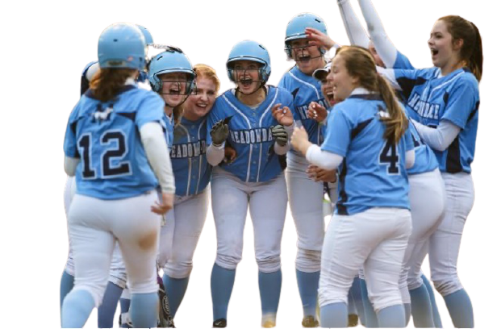
Amanda Sits One Out
Amanda stood up and cheered when the Mayville Marlins scored another run. They were on a roll! After five innings of this weekend’s softball game, the Mayville Marlins were now tied with the Berrytown Badgers. The score was 5 to 5.
Amanda jumped and a pain shot through her ankle. She sat down again hard but continued to watch her teammates give each other high fives and cheer as the runner crossed home plate. She should have been there with the team.
This Photo by Unknown Author is licensed under CC BY-NC-ND

Slide 2
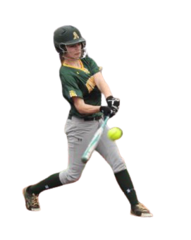
Amanda was so excited at the beginning of the season. Each day last summer she and her father had gone to the field to practice, long before the workers and students were awake. Her father taught Amanda how to catch and throw, and he even taught her how to swing at a curve ball!
Amanda earned her spot on the Mayville Marlins team and was seeing her hard work pay off all season. All was well until the day she tripped over her sleeping cat and twisted her ankle. Now she was in the stands, cheering her team on from the bleachers.
This Photo by Unknown Author is licensed under CC BY-SA

Slide 3
As the fifth inning ended Amanda grabbed her crutches and headed to the concessions for an icy tall soda. She chatted with some friends and listened for action on the field.
Suddenly a roar from the crowd arose. Amanda limped her way back to the bleachers and saw that the Mariners had won the game. The score was now 11 to 5.
How did the Mariners score 6 whole points in just two innings? Do you know how that might have happened?
This Photo by Unknown Author is licensed under CC BY

Slide 5
Click here to download a free student copy of the
Mathematizing Story Map
for Part-Part-Whole problem situations, and more!

