Slide 1
Lightning Carlos
Carlos ran down the soccer field toward the opposing team’s goal. He was on a mission today. It was the last game of the Thunder’s regular season and he had already earned 9 goal assists.
You have to be fast to be the first player to reach the other end of the field, and Carlos knew that he was now the fastest runner on the team. The fastest runner controls the ball, and while they sometimes have a chance to score a goal, mostly they pass the ball to the forward who makes the goal attempt.
This Photo by Unknown Author is licensed under CC BY

Slide 2
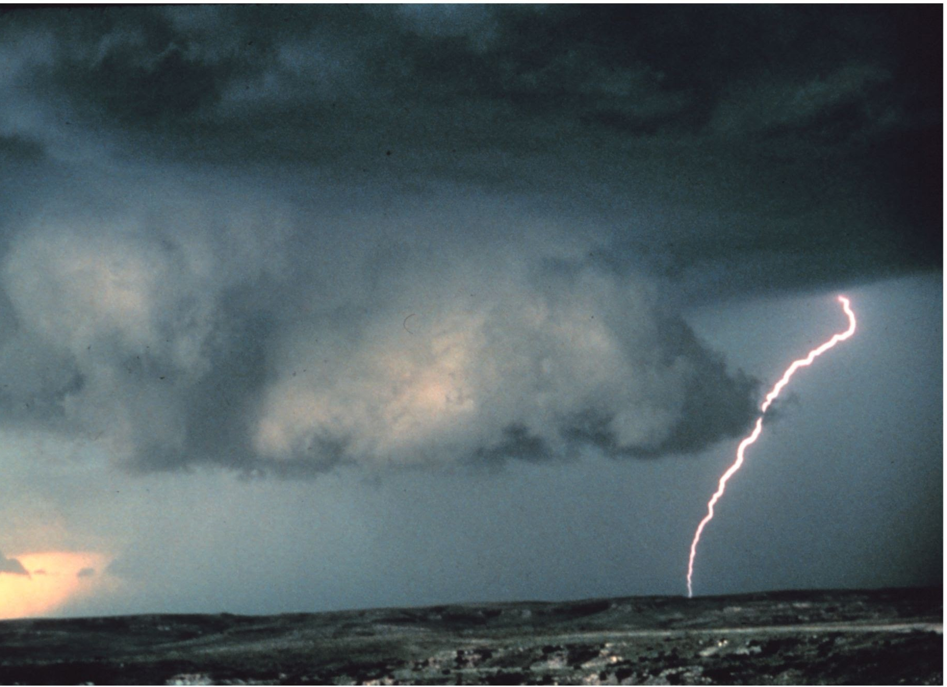
A few months ago, Carlos had started a personal training program to become a faster runner. When he got home from school each afternoon, he did the warm-up stretches his coach had recommended, and he ran. And he ran some more. Carlos wanted to outrun everyone on the field and was willing to work hard to achieve that goal.
Coach noticed Carlos’ progress, and one day he called him “ Lightning,” because lightning is faster than thunder. Did you get that? His team is the Thunder, and he was now faster than thunder!
This Photo by Unknown Author is licensed under CC BY-SA

Slide 3
Coach also said that Carlos might actually beat the record for most assists in a single season. All he needed were 2 more assists to beat the league record.
As the end of the match approached, Carlos was tied with the league record for assists, and he was excited for the opportunity to break the record. He concentrated hard and ran toward the opposite goal as he watched his teammates pass the ball down the field.
The ball was finally passed to him and he dribbled it between his feet before passing it to the forward.
Credit

Slide 4
The forward dodged left, kicked right, and the ball sailed over the head of the goalie! The Thunder scored another goal and Lightning Carlos now held the record for most assists. It was a good day.
I wonder how many assists Carlos made this season.
Credit

Slide 6
Click here to download a free student copy of the
Mathematizing Story Map
for Part-Part-Whole problem situations, and more!

