Slide 1
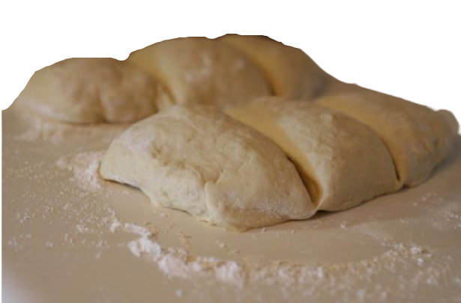
Priya Prepares a Pizza Puzzle
Priya was in charge of dinner tonight. Their mother had a big project due at work, and would be late coming home. Priya decided it would be fun to make miniature pizzas so that everyone could make their own.
She sprinkled some flour onto the counter and turned the pizza dough out on top of it. She rolled it out flat. She cut the dough into 12 equal-sized pieces and wondered whether to add a spicy sauce or a not-spicy sauce.
This Photo by Unknown Author is licensed under CC BY

Slide 2
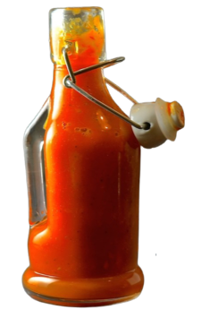
Priya sighed at the thought of eating another pizza with spicy sauce, but she knew her brother and parents liked it.
“Avi, do you want spicy sauce on your pizza?” she said.
“Spicier than spicy!” said Avi.
Priya brought out some sauces and carefully spooned some of each into bowls so that her family could choose their own. She then turned to prepare the toppings.
This Photo by Unknown Author is licensed under CC BY

Slide 3
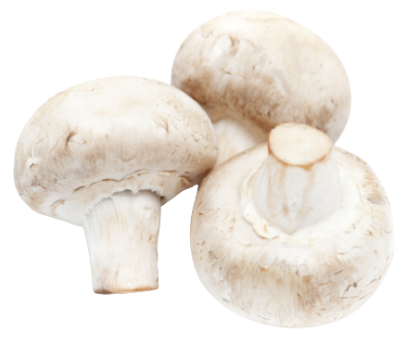
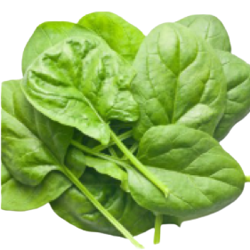
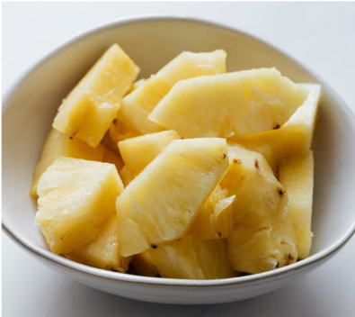
Priya brought the vegetables out of the refrigerator and let her brother and sister pick the toppings they would add. Because the pizzas were so small, Priya warned everyone that they would only be able to add one topping.
Avi counted the miniature pizza dough pieces waiting for toppings and said,
“Let’s make each pizza different. That way everyone can eat the one they want.”
This Photo by Unknown Author is licensed under CC BY-NC
This Photo by Unknown Author is licensed under CC BY

Slide 4
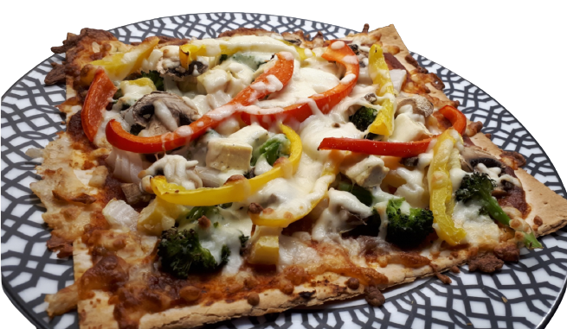
Avi sat down in front of the counter, and tried to figure out how many totally different pizzas he could make. He scrunched up his forehead as he was thinking, wondering what it meant that the pizzas were completely different from each other.
Do you know how many toppings and how many different sauces they should prepare so that there would be 12 unique pizzas?
Notes:
This Photo by Unknown Author is licensed under CC BY-NC-ND

Slide 6
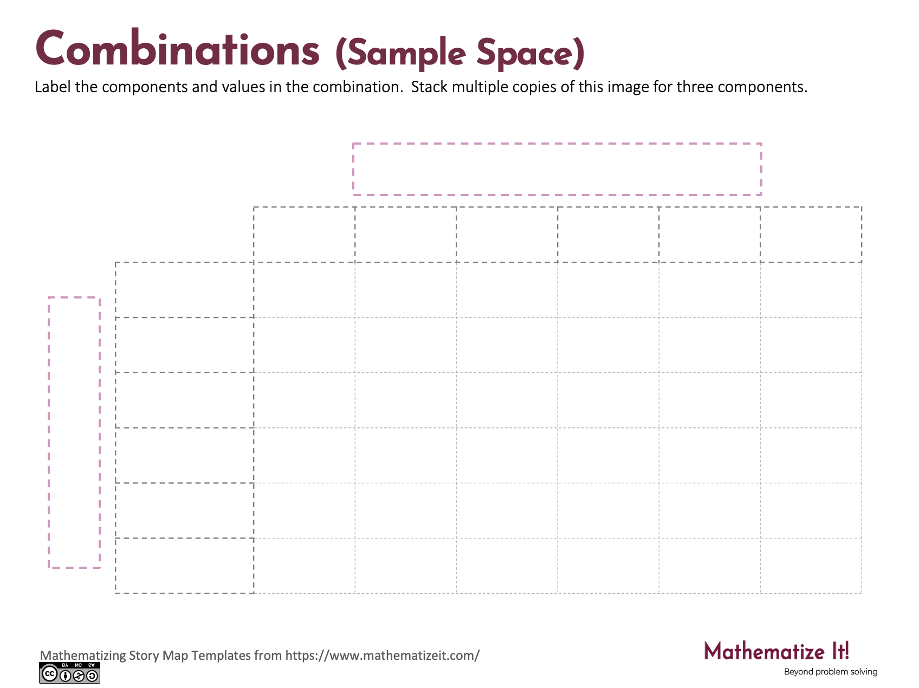
Click here to download a free student copy of the Mathematizing Story Map for Combinations/Combinatorics/Sample Space or Fundamental Counting Principle problem situations, and more!

