Slide 1
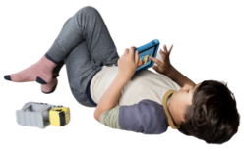
A Castle or a Ranch?
Avi’s hand scribbled across the bottom of the last page in his notebook, and he ended his sentence with a grand swoop of his arm. Period. He finished his social studies assignment, and he checked his list to make sure he had all of his homework done. Check. Check. Check. It was all done, and now he was free to play.
Avi snapped open the case and popped out the cartridge. He pushed the cartridge into his device and leaned back to play.
This Photo by Unknown Author is licensed under CC BY-SA-NC

Slide 2
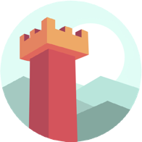
The last time Avi played this game he and his sister Priya had each started with the same number of coins.
Avi wasn’t sure how that happened, but suddenly he saw that his sister had 3,600 coins. He was even more disappointed to notice that he still had the same amount as he started with! How did his sister do that?
“Priya!” Avi yelled. “How did you get 3 times as many coins as I have?”
“It was easy!” Priya yelled back, “I made a castle and some of your friends wanted it, too.
This Photo by Unknown Author is licensed under CC BY-SA

Slide 3
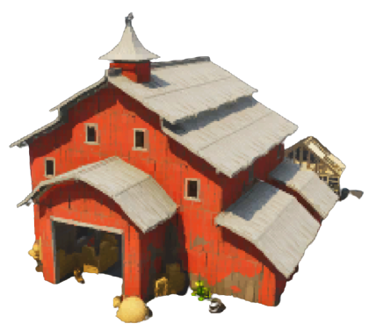
They gave me game coins so they could use it. ”
“You can do that?” cried Avi.
Avi looked back at his game device and decided that he would build a ranch. It would have a barn with space for cows, and horses of course. He would also have to create the best cowboy costume for his character. As he worked on his new project he imagined all of the things he wanted to build now and how he could build up his collection of coins.
Do you know how many coins he started with?
This Photo by Unknown Author is licensed under CC BY-SA-NC
Notes:
This Photo by Unknown Author is licensed under CC BY-NC-ND

Slide 4
Notes:
Note: 6 groups are given in the Equal Groups template. Not all problem situations will have six groups: some will have more and some will have fewer. Ask students to decide how many should be used.

Slide 5
Click here to download a free student copy of the Mathematizing Story Map for Multiplicative Comparison problem situations, and more!

