Slide 1
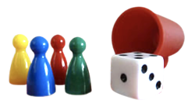
Lakshmi Takes It All
“5, 6, 7, 8,” Lakshmi counted.
“I’ll take it!” she exclaimed excitedly. “How much is it?”
“300 game dollars,” said Avi. Shouldn’t you ask how much it is before you buy it, anyway?”
Lakshmi laughed and tucked her new card under the game board. She bought and she bought some more until she had nothing left to spend. That’s when Ravi made the decision that would cost him the game.
This Photo by Unknown Author is licensed under CC BY-SA-NC

Slide 2
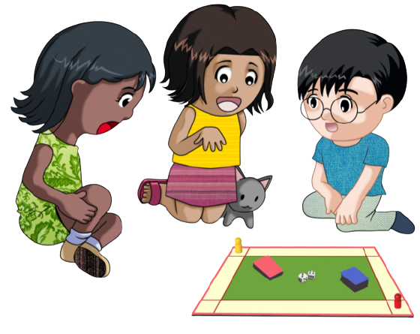
Avi decided to loan Lakshmi some money so that she could stay in the game.
At the end of the game, Avi glanced down and frowned. He saw that he had only 200 game dollars left. Lakshmi was still counting.
2,000 2,500 3,000 3,100
She announced that she had 3,200 game dollars! Everyone else shook their heads and tossed their game dollars onto the board in defeat. They knew she had won the game.
This Photo by Unknown Author is licensed under CC BY-NC

Slide 3
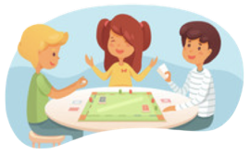
“I hate this game,” muttered Avi. “I always lose!”
Lakshmi laughed and said, “You’re too nice, Avi. I owed you game dollars, and you could have made me pay you. You could have beat me a long time ago, but you gave me a break. It really isn’t fair that I have so much more money than you do.”
Avi went silent. He was trying to figure out how much more money Lakshmi had then he did. Sure, it was 3,000 dollars more, but he wanted to know how much more.
Notes:
This Photo by Unknown Author is licensed under CC BY-NC-ND

Slide 4
Avi thought, “I know she has a lot more than twice as much as I do, but how much more is it really?”
He wanted to know many times the money she had than he did. It seemed like that was a better to say it that way.
Do you know how many times Avi would have to add his money up to get the same number of game dollars Lakshmi has?
This Photo by Unknown Author is licensed under CC BY
Notes:
This Photo by Unknown Author is licensed under CC BY-NC-ND

Slide 5
Notes:
Note: 6 groups are given in the Equal Groups template. Not all problem situations will have six groups: some will have more and some will have fewer. Ask students to decide how many should be used.

Slide 6
Click here to download a free student copy of the Mathematizing Story Map for Multiplicative Comparison problem situations, and more!

