Slide 1
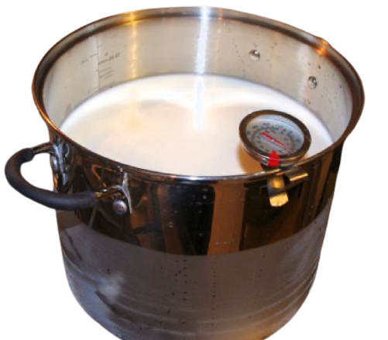
Baba Knows What’s Important
Priya bounced into the kitchen and saw her baba stirring a full pot of hot milk. Priya stopped abruptly and watched intently as her father turned off the heat and poured lemon juice into the hot milk. Immediately the milk changed. The milk went from a smooth, white liquid to a horrible-looking mess of awkward globs of white, surrounded by a clear liquid.
Priya wasn’t surprised by its appearance. She had seen her mom and dad make paneer before. Suddenly, Priya frowned.
This Photo by Unknown Author is licensed under CC BY

Slide 2
Making a cheese like paneer meant one thing-- they were going to a family gathering today.
Baba only made it from scratch for special occasions. Priya couldn’t help but be disappointed because she and her friends had planned to play Go Play! today.
Today was a special Go Play! game day. Every score was five times more than usual and Priya was hoping to level up because of the event. She thought about what that could mean. Normally a good afternoon of play earned 8,000 points.

Slide 3
With the 5 times bonus event, she tried to figure out how many points that would be.
“Priya,” her father interrupted. “Hand me the cloth.” Priya watched as her father strained the liquid away and left the solid cheese behind.
“I was thinking. You can invite Lakshmi with you to the party. I know you were planning to play the special Go Play! event with her, and that is important.”
This Photo by Unknown Author is licensed under CC BY-SA-NC
Notes:
This Photo by Unknown Author is licensed under CC BY-NC-ND

Slide 4
Priya smiled widely and hugged her father, and ran off to invite her friend to the gathering.
She was going to get enough points to level up after all!
I wonder how many points Lakshmi expected to earn during the event?
This Photo by Unknown Author is licensed under CC BY
Notes:
This Photo by Unknown Author is licensed under CC BY-NC-ND

Slide 5
Notes:
Note: 6 groups are given in the Equal Groups template. Not all problem situations will have six groups: some will have more and some will have fewer. Ask students to decide how many should be used.

Slide 6
Click here to download a free student copy of the Mathematizing Story Map for Multiplicative Comparison problem situations, and more!

