Slide 1
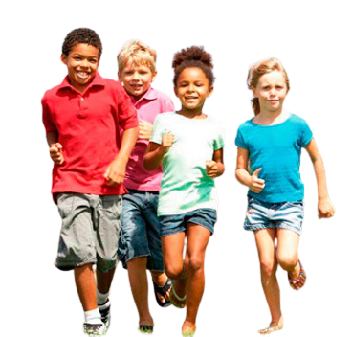
Carlos Takes the Lead
Mrs. Hong held up her hand to get the runners’ attention. The class had finished running their race and it was time to take pictures. but the class was still breathing heavily after running their event. The students were talking and chatting to each other.
Suddenly Carlos yelled, “Stop!” and all 32 students turned to stare at him.
This Photo by Unknown Author is licensed under CC BY-NC-ND

Slide 2
Carlos spoke more softly, “Mrs. Hong is talking to us. C’mon! Stop talking.”
Mrs. Hong stepped forward and told the students that a reporter from the local television station was interested in reporting on their fundraiser. They were going to be on the local news that night, but first the reporter wanted a picture of the students to put on the webpage.
“Please line up,” called the reporter.
This Photo by Unknown Author is licensed under CC BY-SA

Slide 3
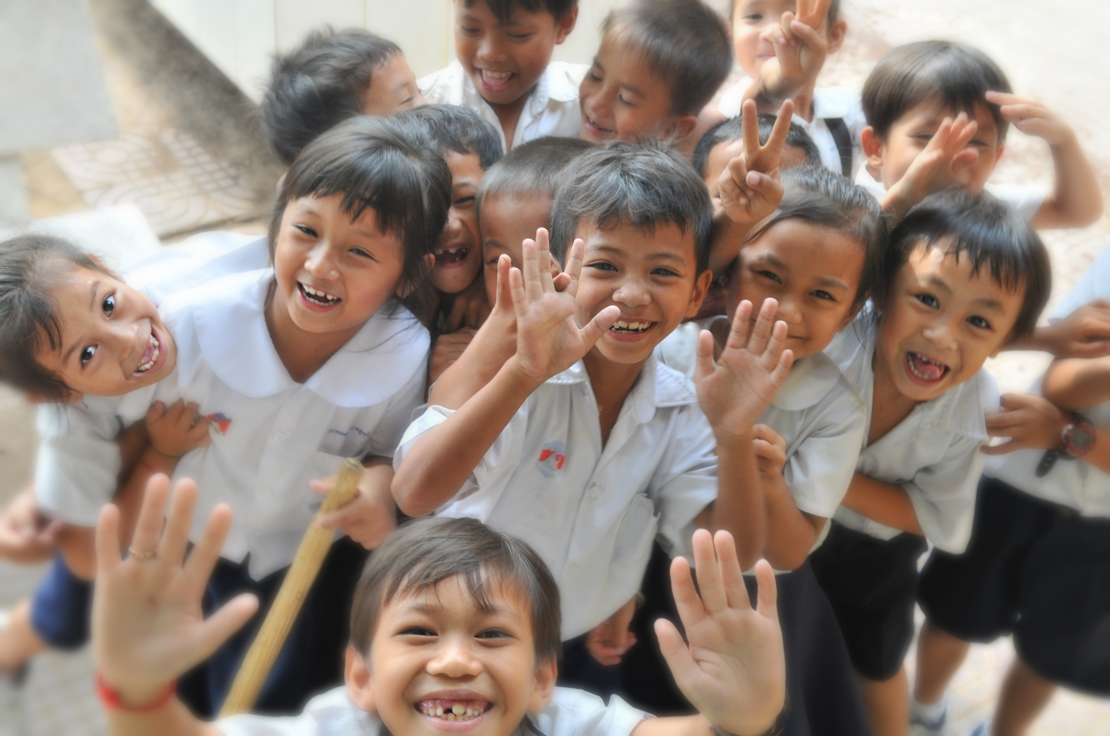
The students starting lining up, and pretty soon they were all in line. Carlos looked down the rows, counted, and said, “Hey! There’s the same number of people in each row! That’s pretty cool!”
I wonder how many students were in each row. Also, I wonder how many rows they made. What ideas do you have?
This Photo by Unknown Author is licensed under CC BY

Slide 5
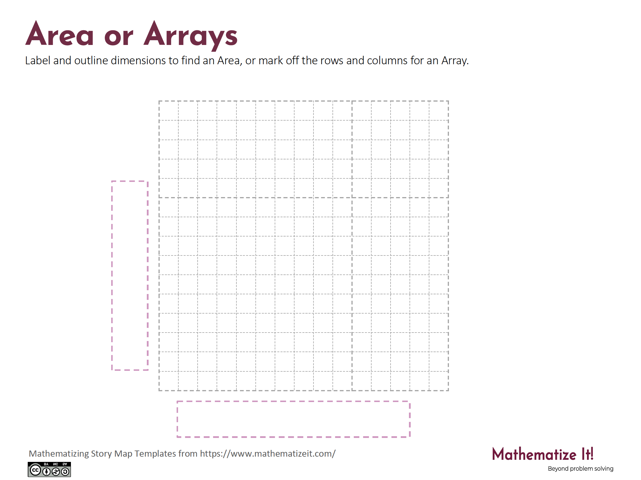
Click here to download a free student copy of the
Mathematizing Story Map
for Area/Array problem situations, and more!

