Slide 1
On the Road to Recovery
Tyler reached into the box and grabbed two more bottles of energy drink. There were 32 bottles inside so he knew there was enough for his class. He dropped them on the refreshment table so hard that they fell over and almost rolled off the table. He grabbed them just before they fell and set them upright with a loud groan of frustration.
Tyler was clearly not happy.
This Photo by Unknown Author is licensed under CC BY-SA

Slide 2
Tyler’s friends were participating in the fun and games and here he was, setting up drinks. It’s not that he didn’t want to help-- he did! But that’s all he was allowed to do.
Last month Tyler had gotten really sick with a virus and he was still trying to get stronger. He had asthma now and had to carry his inhaler everywhere he went.
But, worst of all, he could not run. He couldn’t even try to make the hula hoop spin around his body. He knew he was luckier than some others, but he was still bitterly disappointed.
This Photo by Unknown Author is licensed under CC BY-SA

Slide 3
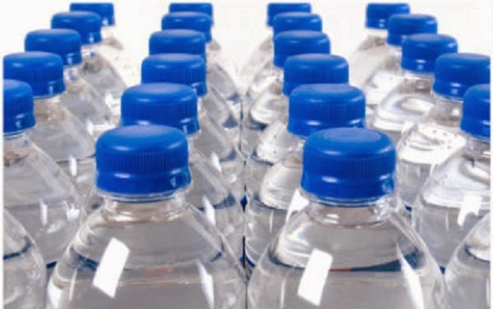
Mrs. Hong walked up to the table. Tyler was embarrassed. She probably saw his outburst, but he didn’t care if other people saw how he felt anymore. But Mrs. Hong was kind. She reached into the box at Tyler’s feet and started to help him arrange the energy drinks on the table. She laid out 4 straight rows and Tyler followed her lead. Together they arranged all of the bottles and waited for the class to circle around again on another lap.
I wonder how many bottles were in each row.
This Photo by Unknown Author is licensed under CC BY

Slide 5
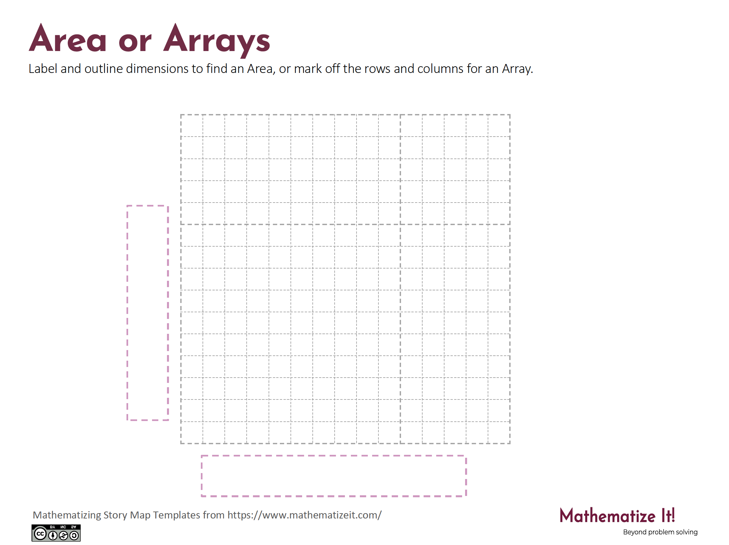
Click here to download a free student copy of the
Mathematizing Story Map
for Area/Array problem situations, and more!

