Slide 1
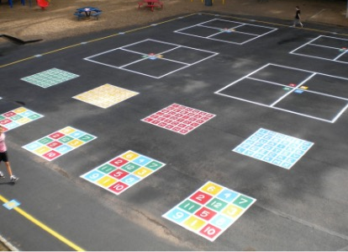
Amanda Marks the Event
Everyone was excited today. They had been planning the sports club fundraiser for several weeks, and it was finally happening. The students enjoyed planning the athletic events and were looking forward to being outside for the day setting up the events for the big event.
The class had already made a map of the school blacktop.
This Photo by Unknown Author is licensed under CC BY-SA-NC

Slide 2
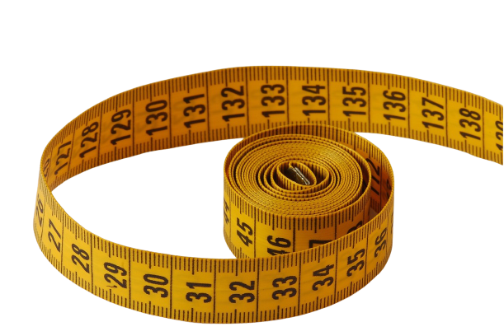
They knew what the blacktop measured on each side, but they needed to draw a box around each individual area. They were starting with the area for the hula hoop event.
This morning Mr. Franklin, the building manager, had blocked cars from coming in so it was safe to set up the activities.
Amanda took the lead. She grabbed the basket of tape measures, the chalk, and the drawings of the blacktop behind the school. The students all headed outside.
This Photo by Unknown Author is licensed under CC BY-SA

Slide 3
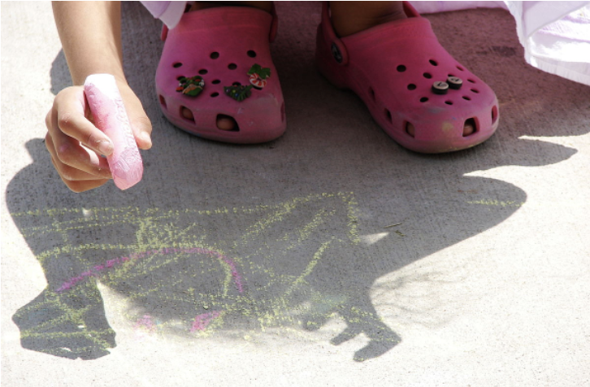
She marked off an 8-yard line and stopped. Then she turned right and started drawing a line that was 9 yards long.
Suddenly she stood up, put her hand on her hip, and said, “Hold on! How much space do we need for the hula hoop event?!” I don’t think I have enough.
How much space had she already drawn for the hula hoop event?
This Photo by Unknown Author is licensed under CC BY-SA

Slide 5
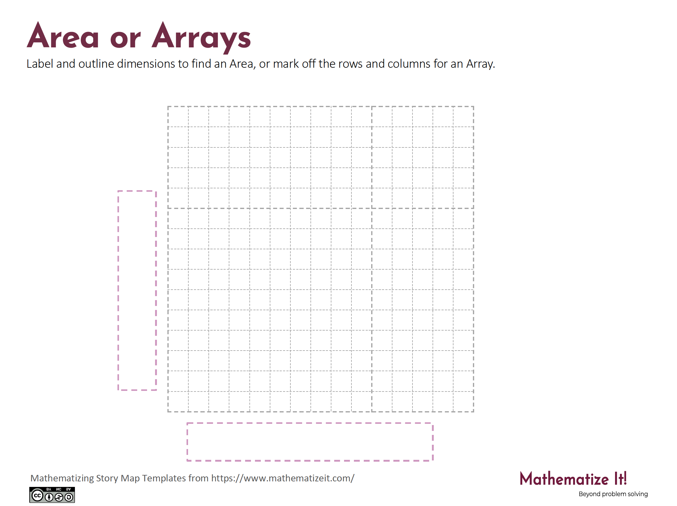
Click here to download a free student copy of the
Mathematizing Story Map
for Area/Array problem situations, and more!

