Slide 1
Metal Man
After seeing the movie Metal Man last summer, Limar decided that it was his new favorite action movie because the main character hero of the movie had an amazing super power.
Metal Man could melt, bend, and shape metal into any form he needed, and he often did that to save people who were in danger. When he was not saving people, the hero was a scientist who made important discoveries about the metals used to build cars.
This Photo by Unknown Author is licensed under CC BY-SA

Slide 2
Limar knew right away that he wanted to build a laboratory, so he could also pretend to be an important scientist, just like Metal Man. He saved his money for weeks to buy a special kit of blocks to build the laboratory. At the store he had clutched the box of building blocks and shivered with excitement. He had planned out the whole laboratory building, and was ready to get to work!
At home he gathered 4 plastic cups and laid them out on the floor, preparing to sort the blocks into four equal groups: one set for each of the walls.
This Photo by Unknown Author is licensed under CC BY-SA-NC

Slide 3
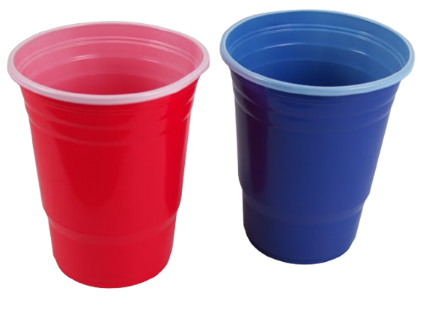
He opened the first bag of blocks, marked with the quantity 64 and sorted his blocks. He was just about to start building when suddenly his mother called out, asking him to set the table for lunch. When he returned to his bricks after lunch, he saw that one of the cups was gone! It was Alisa! His little sister had taken a cup of bricks.
I wonder how many bricks his sister Alisa had. Do you know?
This Photo by Unknown Author is licensed under CC BY-SA
Notes:
This Photo by Unknown Author is licensed under CC BY-SA

Slide 4
Notes:
Note: 6 groups are given in the Equal Groups template. Not all problem situations will have six groups: some will have more and some will have fewer. Ask students to decide how many should be used.

Slide 5
Click here to download a free student copy of the
Mathematizing Story Map
for Equal Groups problem situations, and more!

