Slide 1
Limar’s Favorite
Limar wasn’t paying much attention to what he was doing. His lola handed him a tray of 30 lumpia to pass out to the family members who were visiting this Saturday afternoon. His grandmother also told him to make sure each person took 3 lumpia.
But Limar wasn’t paying attention to the tray in his hands. Instead, he was thinking about the adobo Lola was making. The delicious aroma floated past his nose, making his tummy rumble.
This Photo by Unknown Author is licensed under CC BY-SA

Slide 2
Sweet, tangy, and rich, adobo was Limar’s favorite dish. Scoop the saucy chicken into a bowl over steamy, hot rice, and there is nothing better!
Limar shook his head and looked down at the tray. He knew that everyone had taken three lumpia. They had patted him on the arm, and said, “Salamat,” so Lola should be happy that he had done his job..
This Photo by Unknown Author is licensed under CC BY-SA-NC

Slide 3
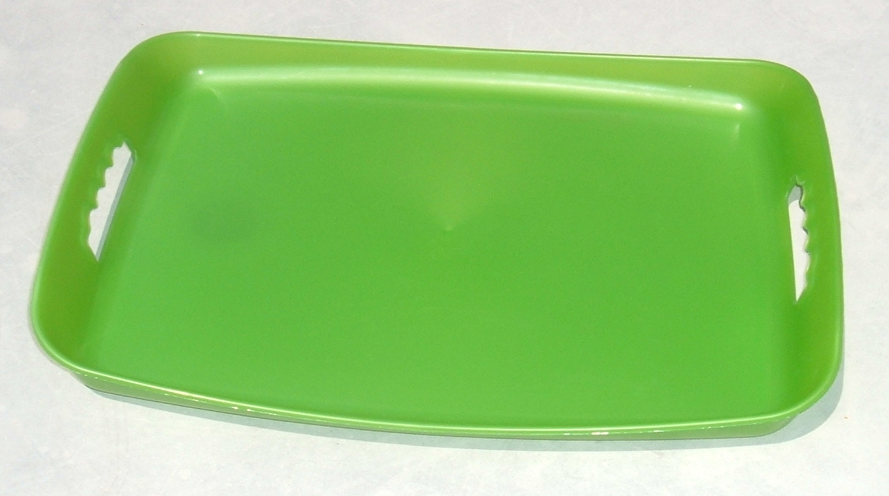
Except, when Limar returned to the kitchen Lola had one more question, and he was not prepared to answer it.
“Li, how many people have arrived so far?”
Do you know how many family members had already arrived?
This Photo by Unknown Author is licensed under CC BY-SA
This Photo by Unknown Author is licensed under CC BY-SA
Notes:
This Photo by Unknown Author is licensed under CC BY-SA

Slide 4
Notes:
Note: 6 groups are given in the Equal Groups template. Not all problem situations will have six groups: some will have more and some will have fewer. Ask students to decide how many should be used.

Slide 5
Click here to download a free student copy of the
Mathematizing Story Map
for Equal Groups problem situations, and more!

