Slide 1
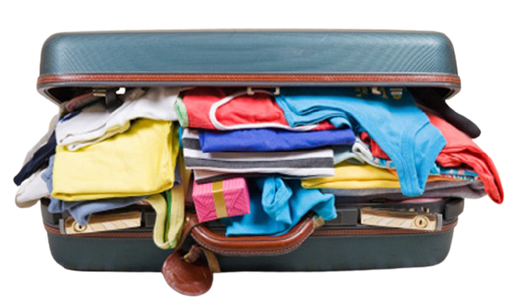
Meaningful Little Gifts
Alisa climbed up on the chair and peered down into the big suitcase Mama was packing. Inside she saw shirts, pants, socks, and shoes. There were so many new shirts, folded and stacked in the center of the suitcase! She carefully counted 18 brand new t-shirts. Alisa wondered who would wear so many different shirts.
Mama reached into another store bag and pulled out something flat and slipped it in between the clothing and the side of the suitcase. Another flat package came out of the bag and it slid in next to the first.
This Photo by Unknown Author is licensed under CC BY-SA-NC

Slide 2
“What’s that, Mama?” she asked.
“It’s a gift of new sheets for your Ninang Aurora, little one.”
“But, why?” Alisa demanded.
Mama stopped to think for a moment. Each year her own father, Alisa’s grandfather, travels to visit family who do not live in the United States. When he is there Lolo visits his mother and his many brothers, sisters, nieces, nephews, and cousins.
This Photo by Unknown Author is licensed under CC BY-ND

Slide 3
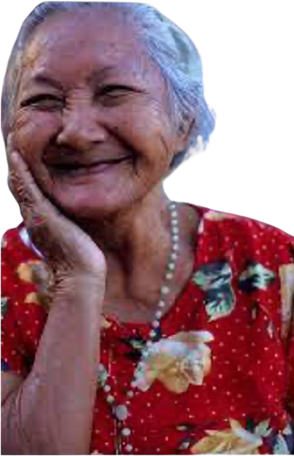
In the home country it is hard to find many things, including t-shirts and brand new bed sheets. Mama wanted to find a way to help Alisa understand how important these gifts were to their family across the ocean.
“Come here, Alisa. Look at this picture of my lola. Look at her bright smile!”
Alisa looked down at the kind woman smiling back at her from the picture printed on shiny paper. The woman in the picture was holding a package just like the one mama had just slipped inside the suitcase.

Slide 4
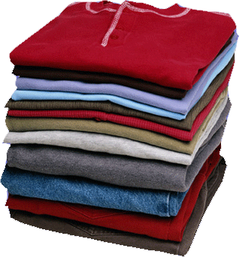
She did look very happy! Also in the picture was a whole crowd of small children, each smiling and clutching a neatly folded shirt.
“I really don’t remember how many shirts we sent that year, but I know that we now send 10 more than we used to,” said Mama.
“I know how many you used to send!” said Alisa.
Do you know how many shirts Alisa’s mother used to send?
This Photo by Unknown Author is licensed under CC BY-NC

Slide 6
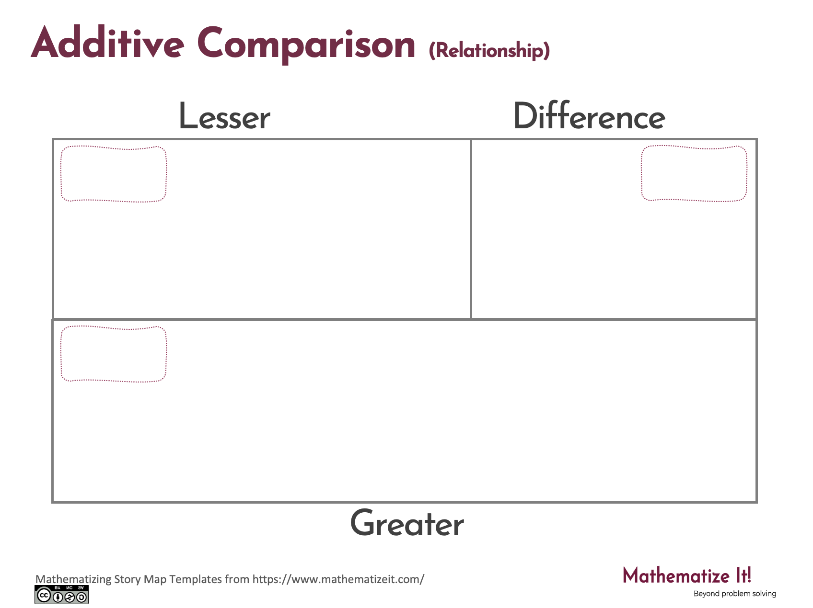
Click here to download a free student copy of the
Mathematizing Story Map
for Additive Comparison problem situations, and more!

