Slide 1
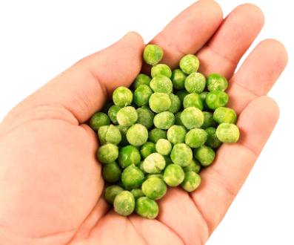
When Little Sisters Count
Limar regretted teaching his sister to count. To be honest, she didn’t really learn from him, but he was willing to count with the family as she learned. Every night at dinner Alisa counted the plates. She counted the forks. She counted the potatoes. She even counted her peas!
The first sign that Alisa’s counting affected Limar was the day she took his plastic bricks and started counting them. 1, 2, 3, 4, 5, 6… Ugh! How much can one little girl count??
This Photo by Unknown Author is licensed under CC BY

Slide 2
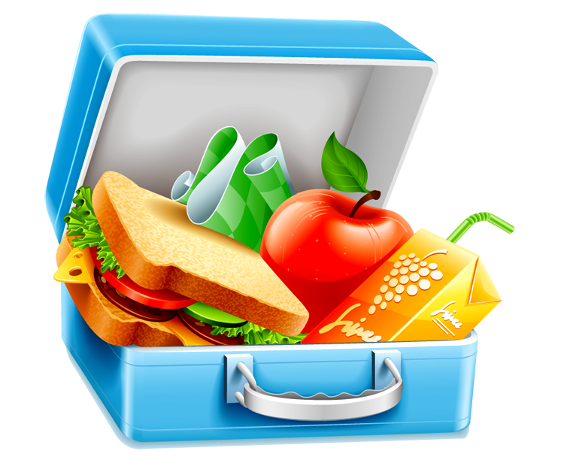
One day, while they were packing lunch, Alisa started counting the snack crackers in her lunch.
“15 crackers!” she yelled out.
But then she started counting Limar’s snack crackers. She stopped for a second and looked back at her own snack crackers. Limar could see a frown cross over Alisa’s face as she looked back at her own baggie of snack crackers and then back at his again. He knew what she was seeing. He knew that she was counting. He knew what was coming.
This Photo by Unknown Author is licensed under CC BY-NC
This Photo by Unknown Author is licensed under CC BY-NC

Slide 3
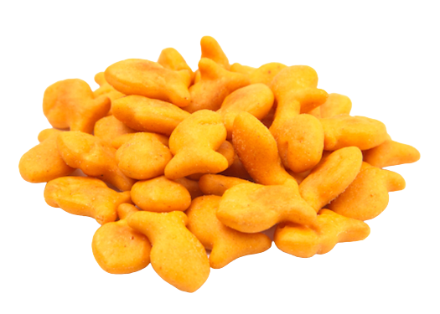
Hey!” Alisa cried out. “Limar has 5 more crackers than I do! That’s not fair!”
Mama calmly stepped in and said, “Of course he does, little one. He is older than you are.”
I wonder how many snack crackers Limar had.

Slide 5
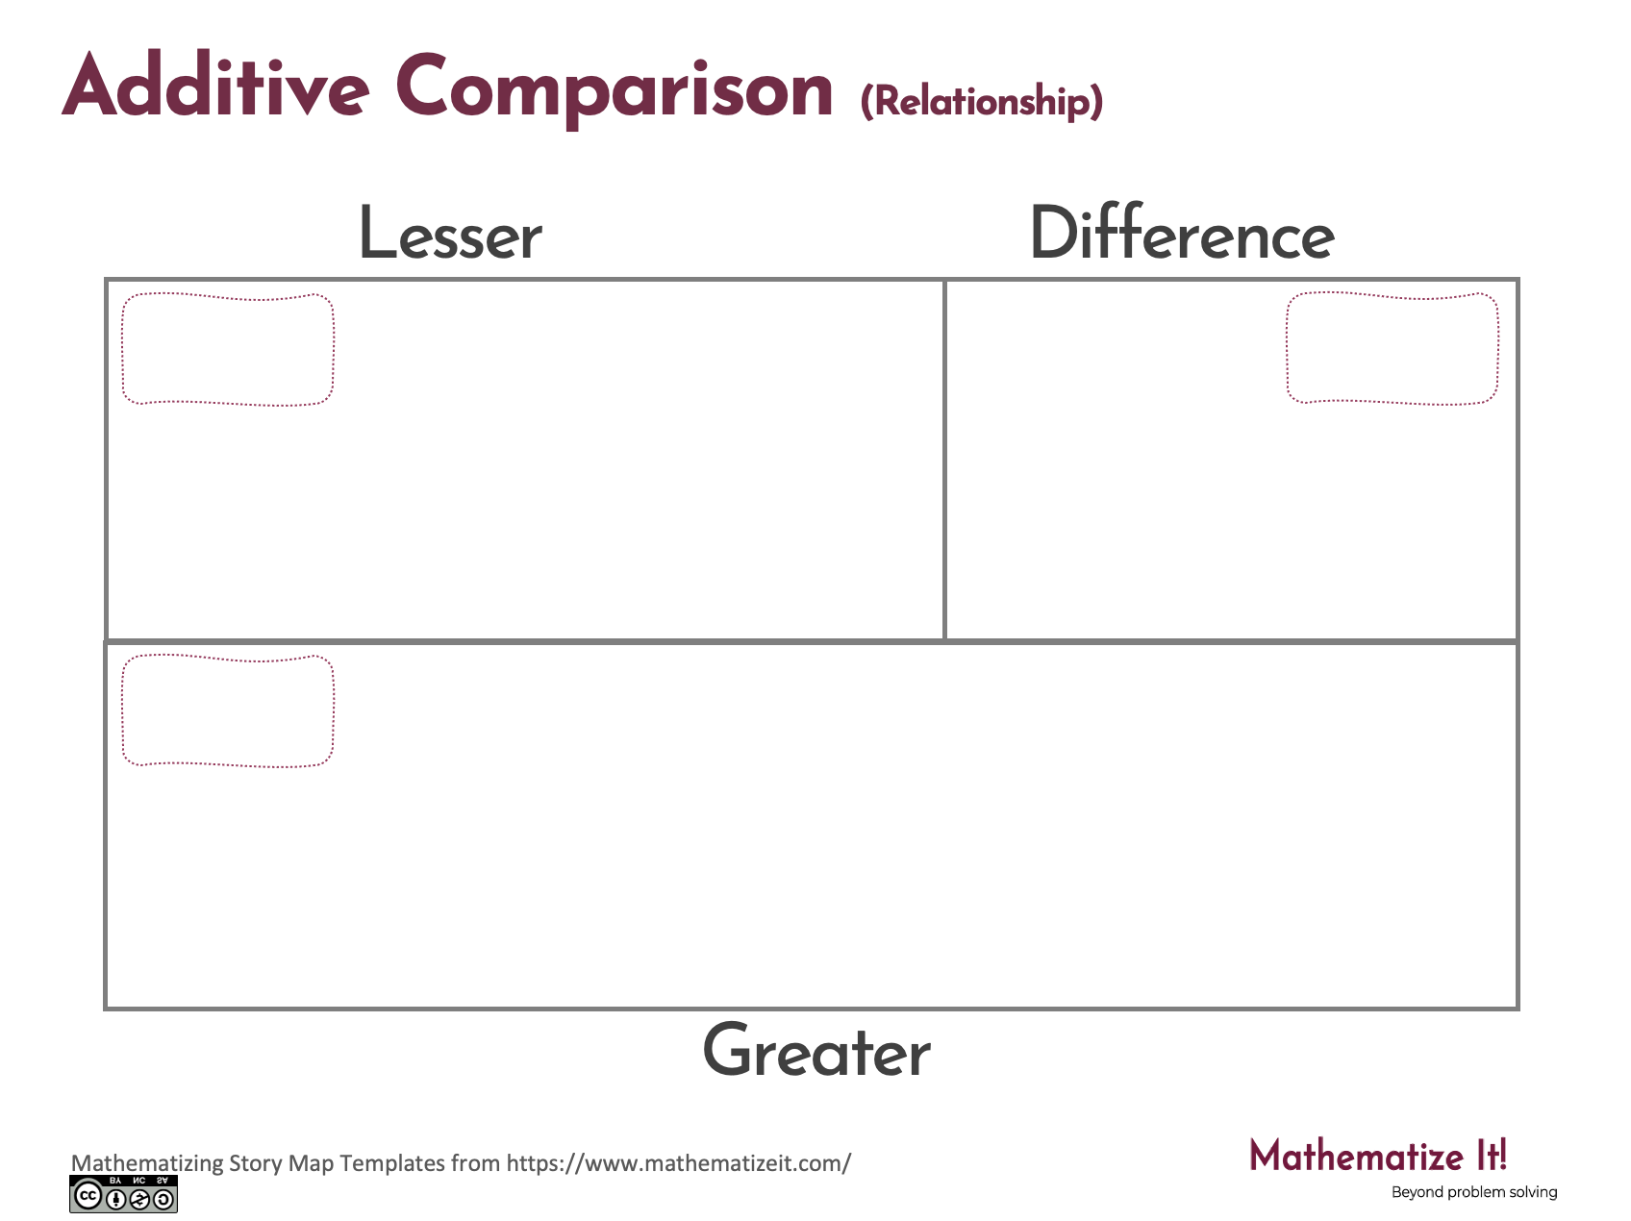
Click here to download a free student copy of the
Mathematizing Story Map
for Additive Comparison problem situations, and more!

