Slide 1
To Make an Important Choice
Limar stood in the long toy aisle and looked up the rows of toys to his right. He turned his head to the left and looked back to the other side. He wished that the toy aisles in this store weren’t separated into boys’ and then girls’ aisles. He was looking for gifts for all of his 18 cousins, and this way it was definitely harder for him to find what he wanted.
Each year Limar’s family visits the toy section of a local store and puts together a box full of their favorite toys.
This Photo by Unknown Author is licensed under CC BY-NC

Slide 2
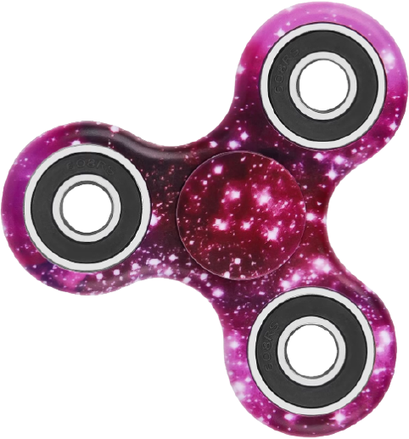
The box is then sent all the way across the ocean to all of those faraway cousins he remembers only meeting one time.
Limar always hopes that he makes the right choices. Two years ago they sent fidget spinners, the kind that light up when you spin them. Everyone loved those.
The next year his family packed up programmable miniature robots. That toy was very popular, but when the cousins used up all of the extra batteries, it wasn’t as fun.
This Photo by Unknown Author is licensed under CC BY-NC

Slide 3
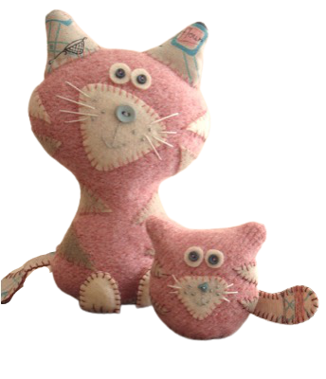
As Limar stood in the aisle thinking hard about his important decision, Alisa, his little sister, ran around the corner and bounded up to him holding the silliest, squishiest, thing he had ever seen. It looked like a cat, but it was pink. It looked silly, but he had to admit-- it was kind of cute. Alisa was squeezing the squishy toy around the middle which made the head look twice the size of a normal cat head.
“Don’t you just want to squeeze it, Limar?!” she exclaimed loudly.
He had to admit. It was cute.
This Photo by Unknown Author is licensed under CC BY-ND

Slide 4
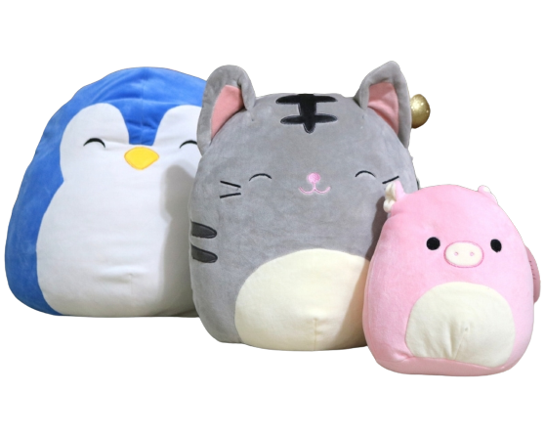
“Show me where you found that, Alisa.”
Alisa took his hand and led him to the next aisle where dozens of squishy faces started back at them. Together they picked out their favorites and placed them in the shopping cart. When they were done Alisa counted 21 squishes, all different types.
“Wait!” said Limar. “That’s too many. We have more toys than we have cousins. We have to put some back.”
Do you know how many they have to put back?
This Photo by Unknown Author is licensed under CC BY-NC-ND

Slide 6
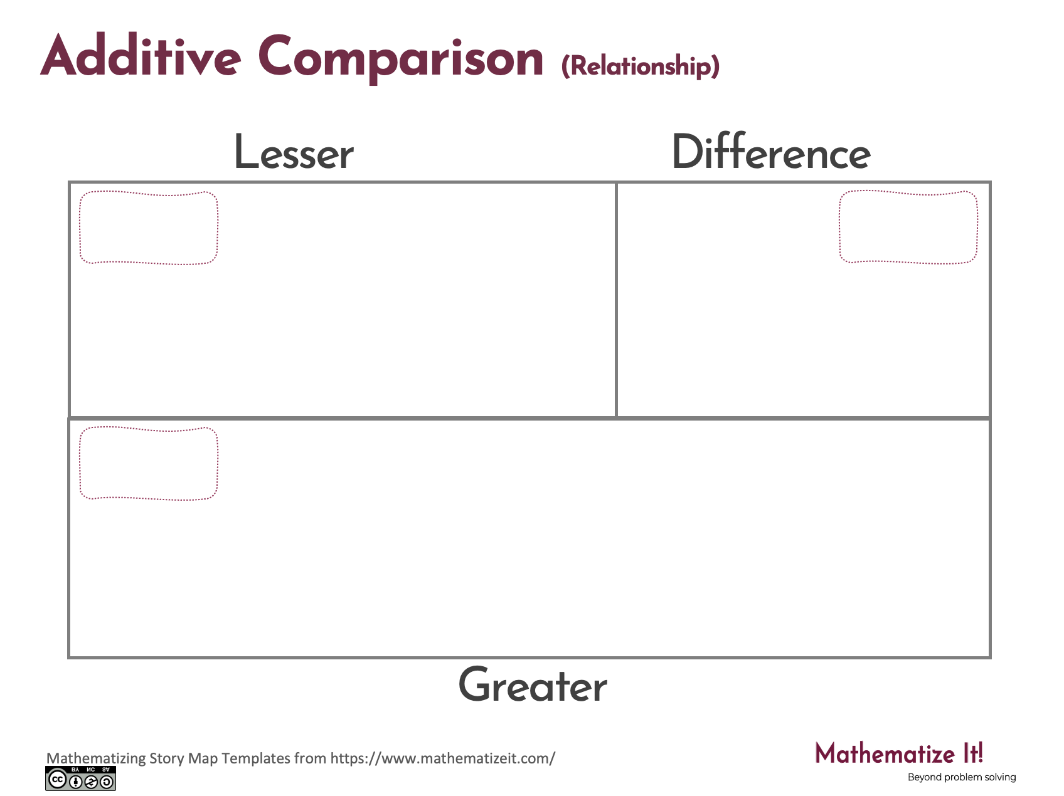
Click here to download a free student copy of the
Mathematizing Story Map
for Additive Comparison problem situations, and more!

