Slide 1
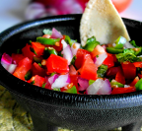
Maya in the Kitchen
Maya carefully used a spoon to scoop the seeds out of the five jalapeños Abuelita passed to her, just as she had been taught. “Remember, Maya, don’t touch your eyes!” Abuelita called out as she worked across the table. Maya thought back to last year, when she was little.
On a Sunday afternoon much like today Maya stood on a chair next to her grandmother’s sink.

Slide 2
She reached into the metal bowl full of shiny jalapeño peppers grown in Abuelito’s garden, and she swooshed her hands in the cool water to get the dirt off. The bright green fruit bobbed in the water, always coming to rest on the surface. Maya couldn’t resist. She plucked a pepper out of the bowl and popped it into her mouth. Crunch!
At first nothing happened, but suddenly Maya felt a hot wave across her tongue. It made her eyes water.

Slide 3
Abuelita noticed Maya was quiet, saw the half-eaten jalapeño in her hand, and quickly figured out what happened. “Apurate! Spit it out! Quickly!”
This Sunday Maya knew better. She knew to only eat the small diced up pieces that go in Abuelita’s Sunday salsa and to never touch your eyes. She swiped the jalapeños back into the bowl and counted, saying, “That’s 12 jalapeños ready to go!” As she carefully washed her hands, Maya wondered how many jalapeños Abuelita had seeded.

Slide 4
Created by: Kimberly Morrow-Leong & Sara Delano Moore

Slide 5
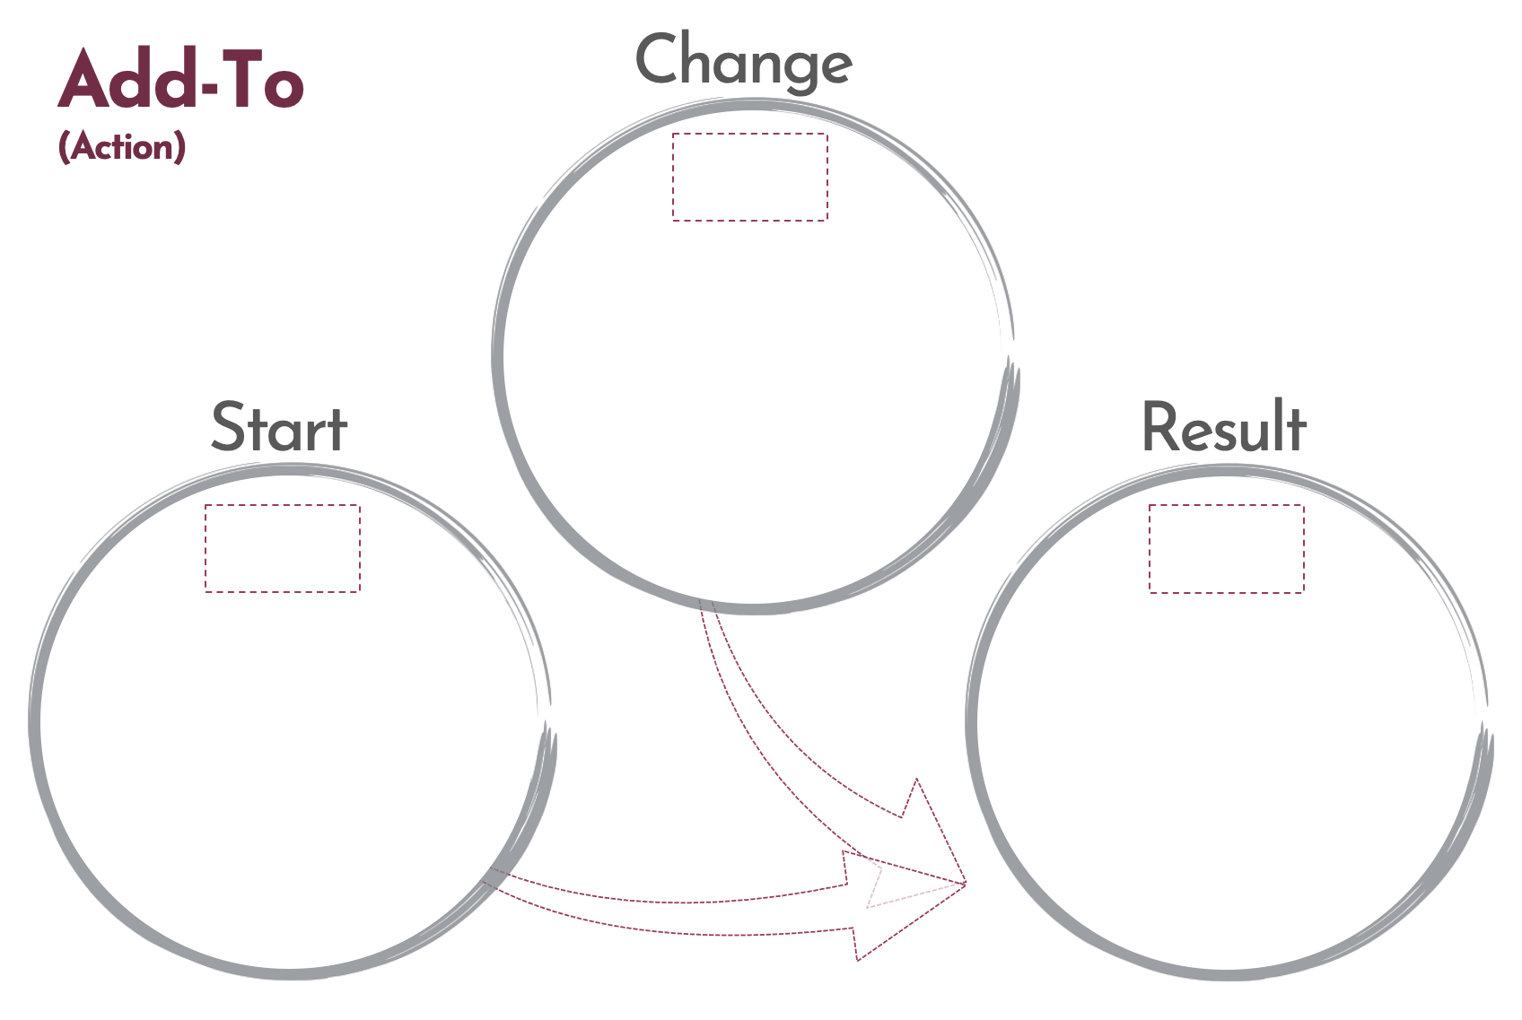
Click here to download a free student copy of the
Mathematizing Story Map
for Add-To problem situations, and more!

