Slide 1
Maya in the Garden
Maya looked forward to working in the garden with her abuelito. She liked how Abuelito talked softly to her, like she was the most important girl in the world. Abuelito liked to feel the soil between his fingers, but Maya still didn’t like the dirt under her fingernails.

Slide 2
This week her grandfather was taking caterpillars off the young plants. He didn’t want the caterpillars to eat the fresh, sweet leaves of his tomato plants, but Maya knew that he would never hurt them. He put three caterpillars in a box and then gave the box to Maya. They kept collecting. Maya took 11 more caterpillars from her grandfather before looking down and counting how many they had.
Do you know how many caterpillars they collected?

Slide 3
Created by: Kimberly Morrow-Leong & Sara Delano Moore

Slide 4
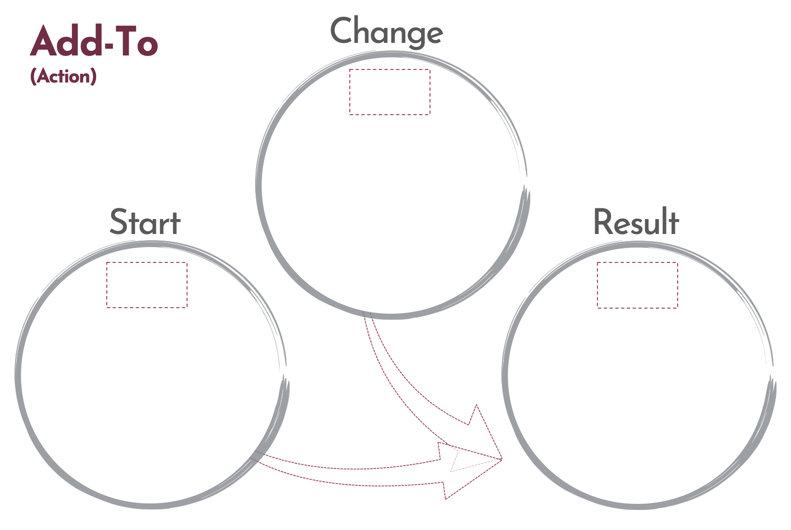
Click here to download a free student copy of the
Mathematizing Story Map
for Add-To problem situations, and more!

