Slide 1
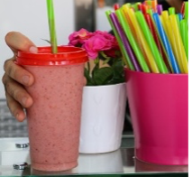
Maya at the Farmers’ Market
Maya wasn’t even fully awake when her little brother jumped on her bed and woke her up.
“We’re ready to go! Get up already!”
She pushed him away and sat up sleepily. Normally she loved the time her family spent at the market on Saturdays, buying fresh food for their meals later in the week. She loved the fresh breads, juicy new fruit, and even Mom’s pushy friends who liked to pinch her cheeks and smile.

Slide 2
Today was different. All nine members of Maya’s film club wanted to meet at the smoothie shop at the same time she was supposed to go to the market! They were planning to meet at the smoothie shop and then go to Julissa’s house. It was fun to watch TV at Julissa’s house because they had a room just for watching TV! Imagine that! Today they were planning to watch a brand new anime movie, and Maya was sad she was going to miss it!
She dragged herself out of bed, pulled on a sweater and pants and stomped heavily down the hall.

Slide 3
The family piled into the car and pulled into the last parking space in front of the market. It was so busy! Suddenly she saw Julissa. Her family was also at the market!
Julissa bounded across the fruit section, grabbed Maya’s arm, and said,
“You’re here! Finally! My mom talked to your mom and you can come with us after you’re done shopping! Everyone will be there in a few minutes.
I wonder how many people are already at the smoothie shop?

Slide 4
Created by: Kimberly Morrow-Leong & Sara Delano Moore

Slide 5
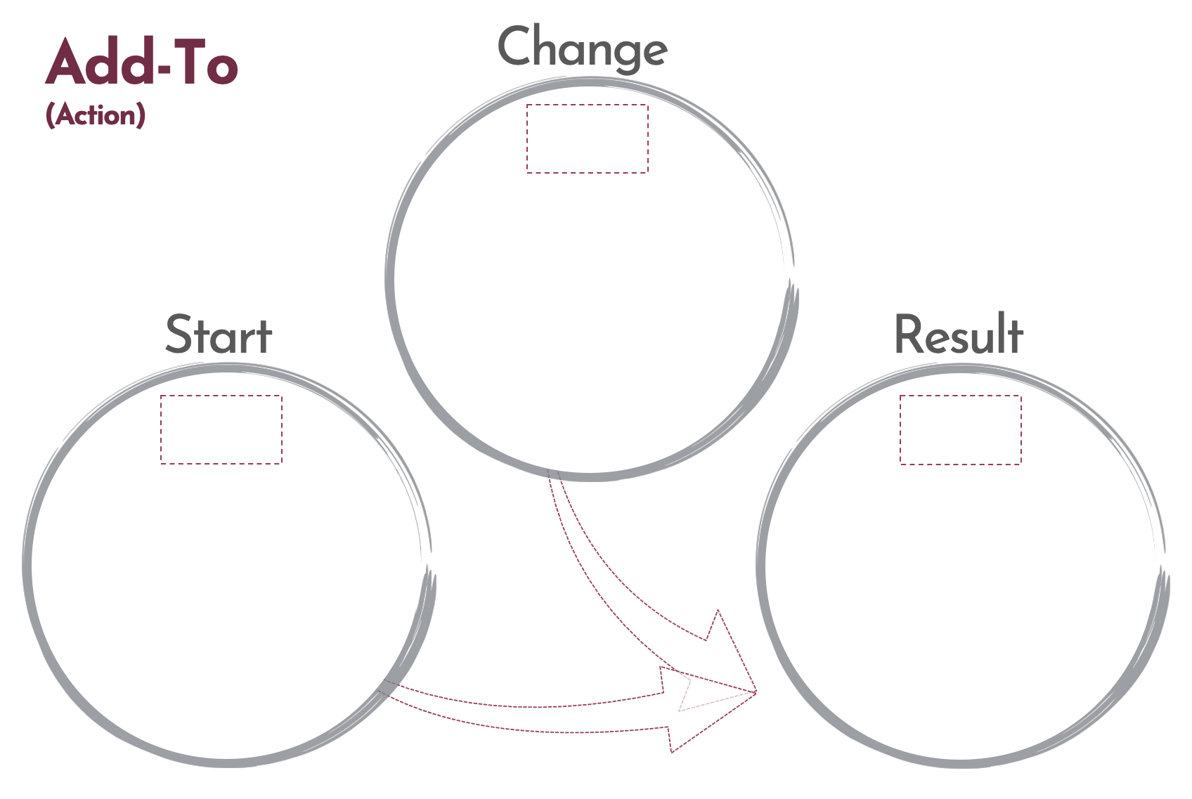
Click here to download a free student copy of the
Mathematizing Story Map
for Add-To problem situations, and more!

